Slide 1

Sample-sequence-interpretation pipeline

Slide 2
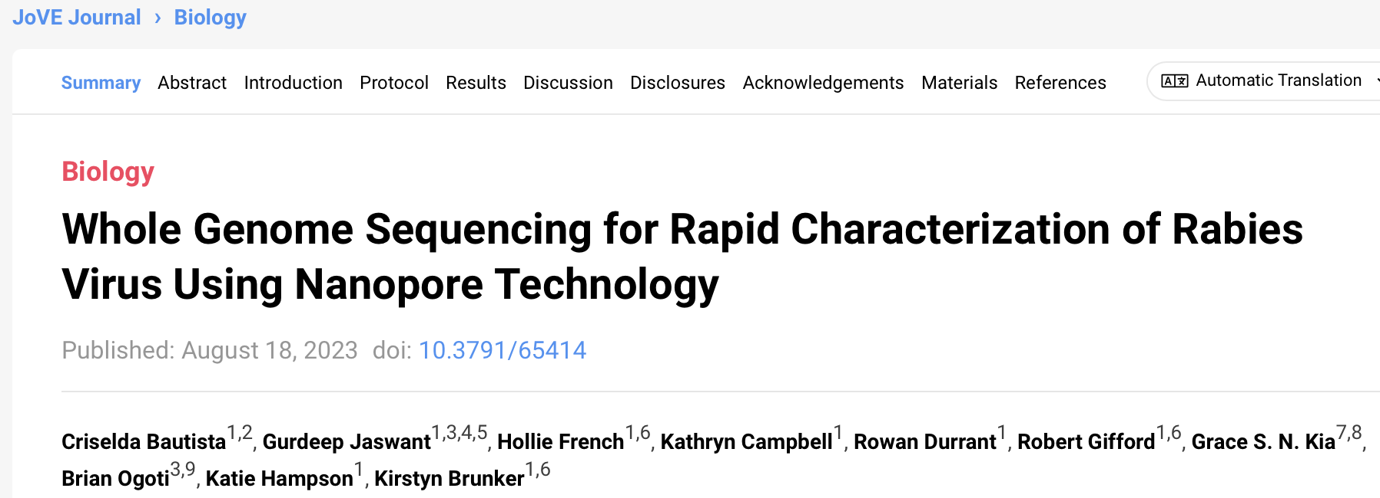
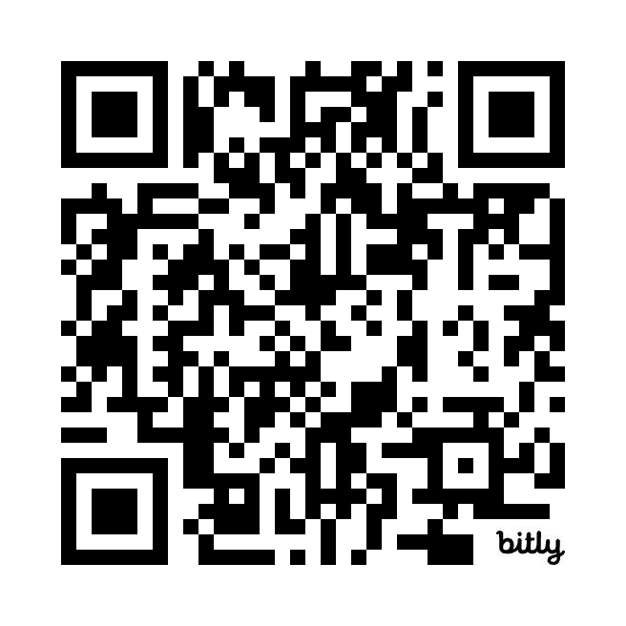
Sample-sequence-interpretation workflow
bit.ly/3HNX2tT
Notes:
Jove protocol QR code

Slide 3
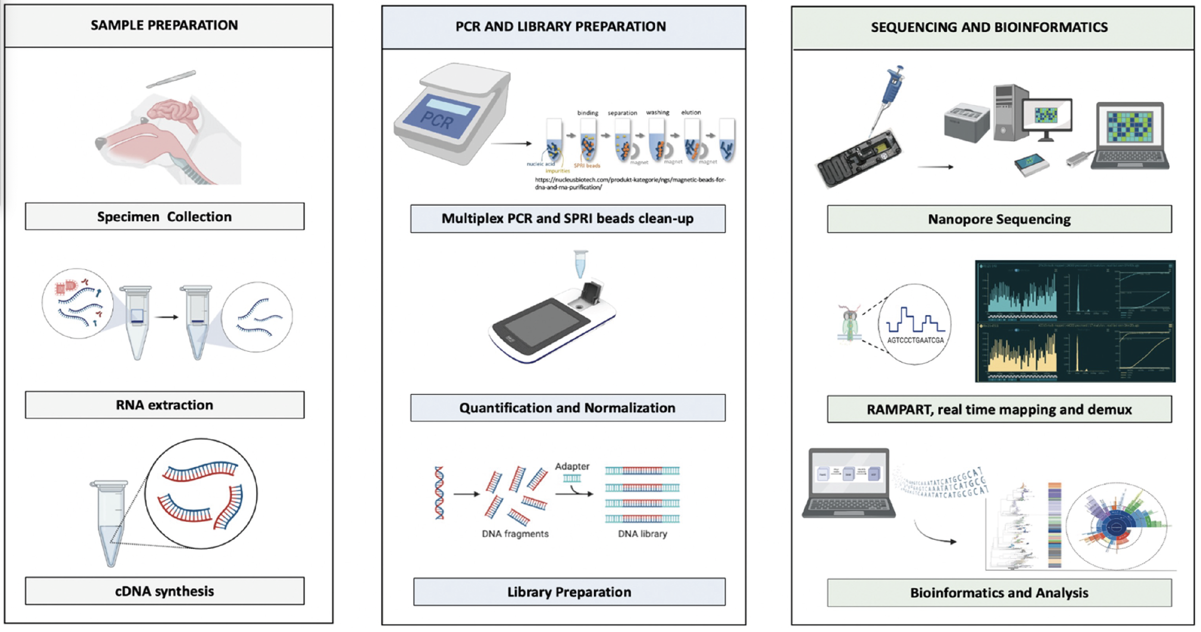
Sample-sequence-interpretation workflow
Bautista et. al., 2023 [JoVE]

Slide 4
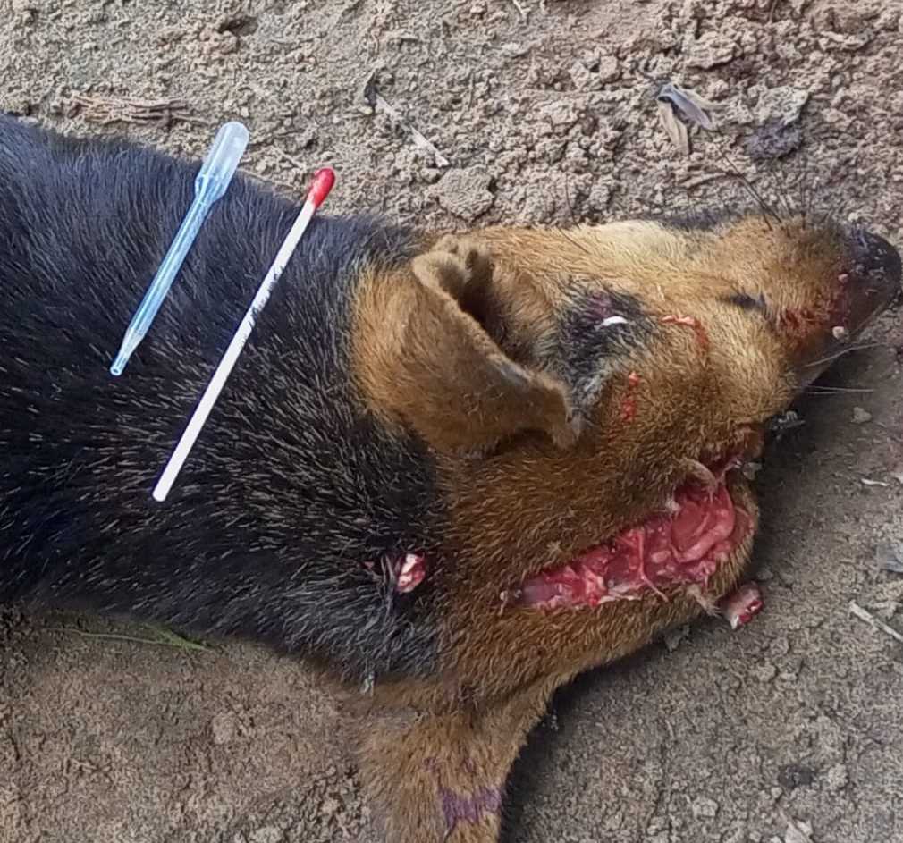
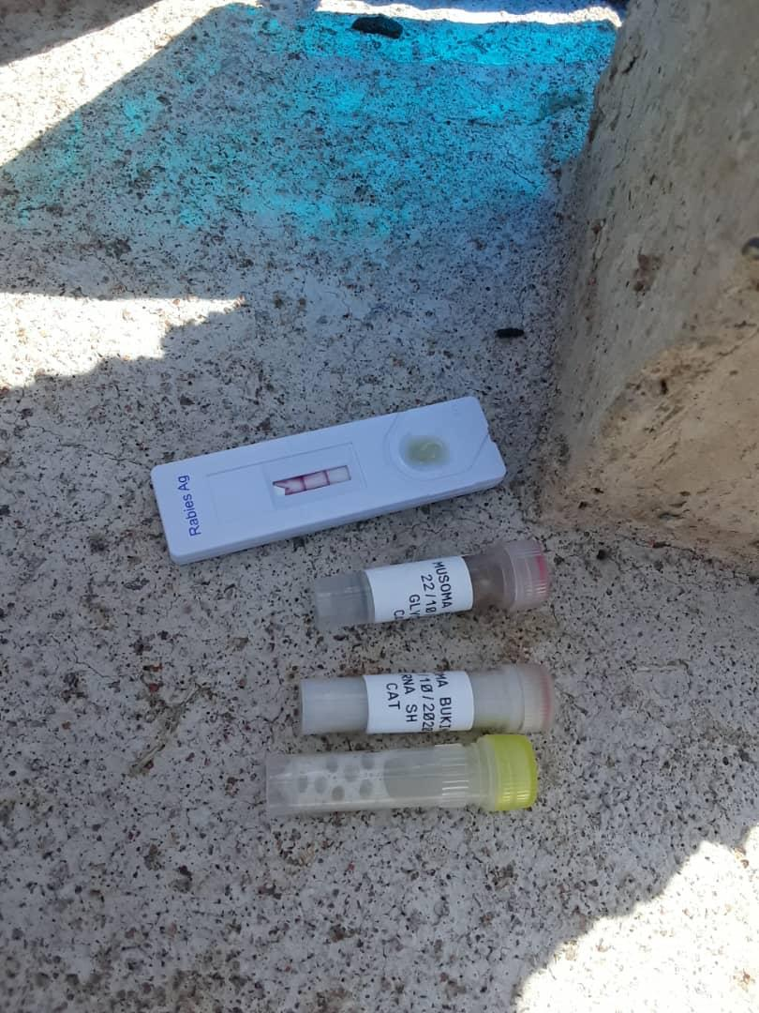
Sampling – Rabies samples
Sample collection (brain sample)+ rapid test is performed in the field
Biosafety Requirements
1. Pre-Exposure Prophylaxis
2. Proper PPE
3. Proper disposal of carcass

Slide 5
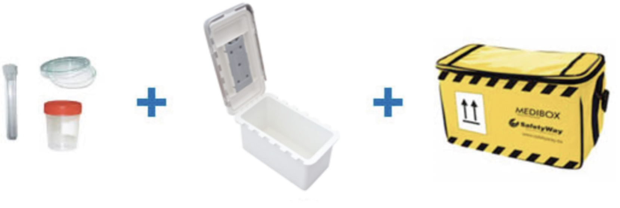
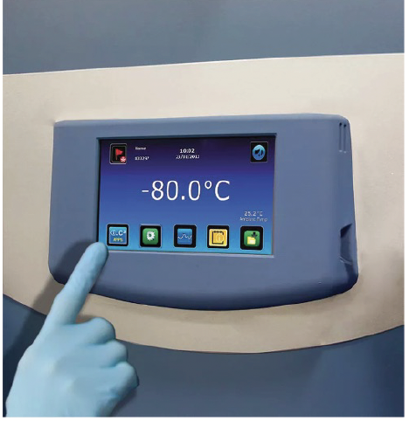
Sample preparation
Sample Quality Check
Use RNA stabilization/ preservation buffer
Ensure good quality samples
a. Properly labelled samples
b. Triple packaging system
c. Good transport conditions: at least 4℃
Sample storage
1. Ultra low Freezer -70 / -80
2. Sample in RNA shield - room temp for months

Slide 6
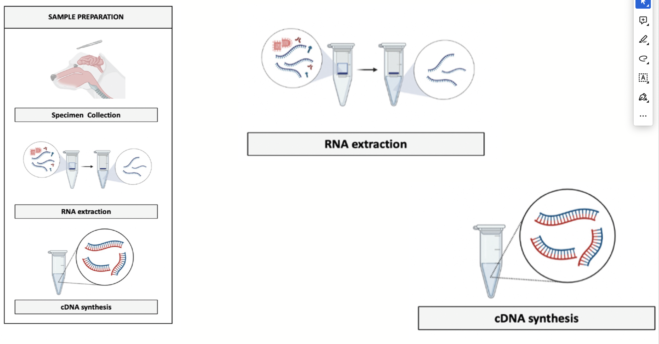
RNA extraction – cDNA synthesis

Slide 7
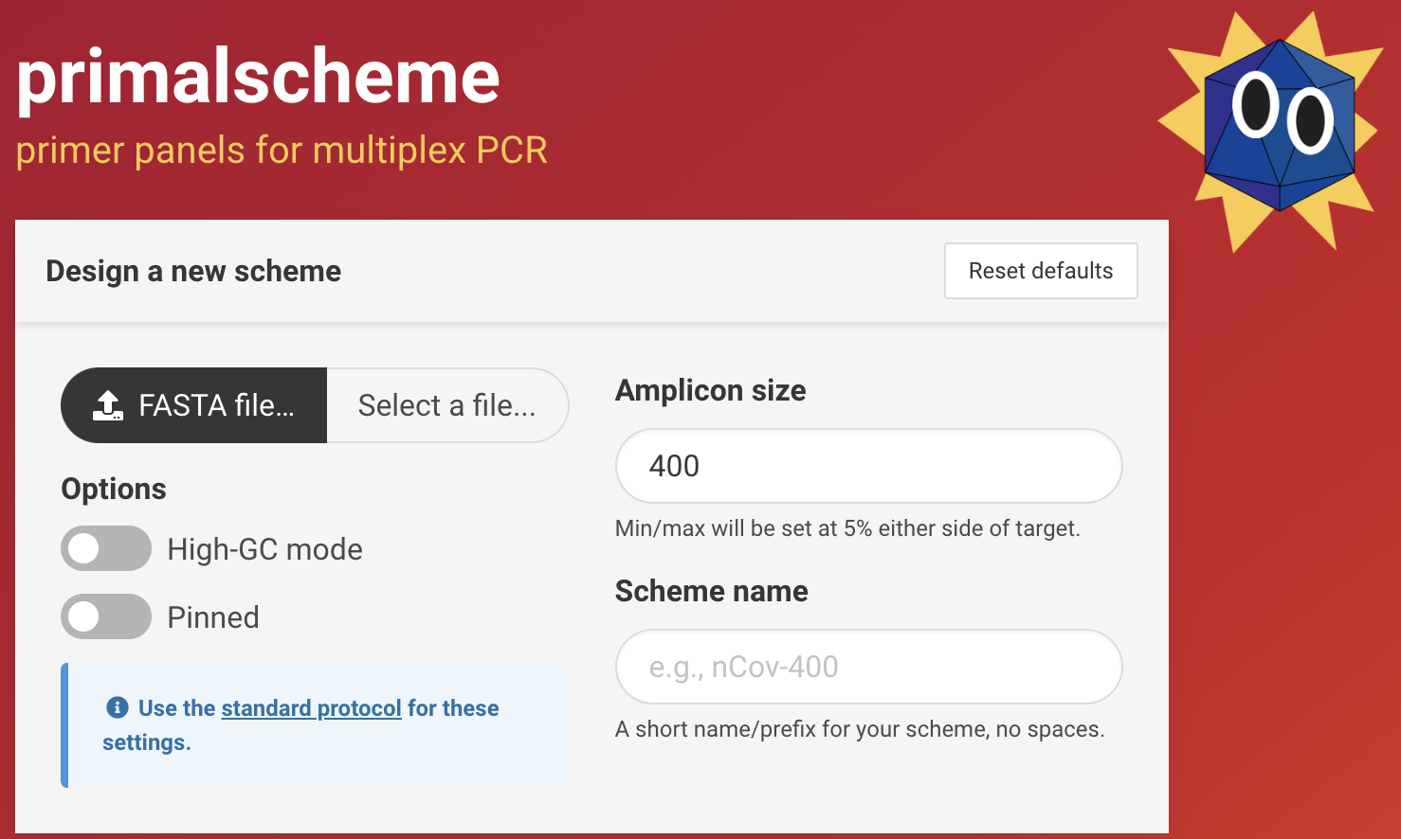
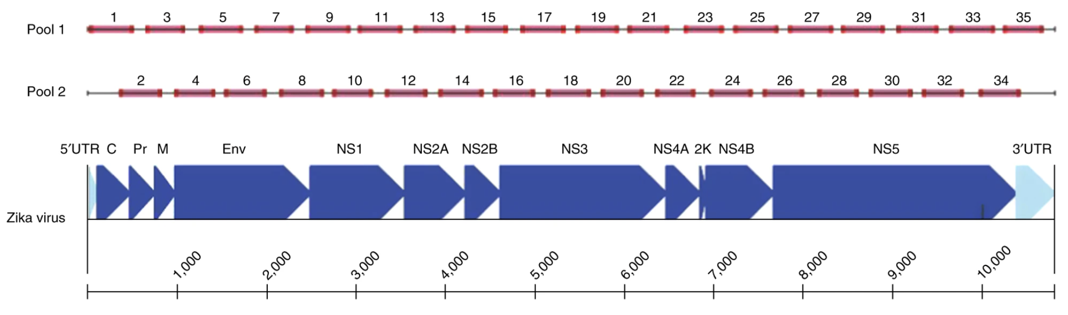
Multiplex PCR
• References: From Genbank, East Africa/Peru/Philippines/Nigeria/Malawi rabies virus WGS
• Short fragments(~400bp)
• Initially developed for Zika sequencing (high Ct clinical samples)
• Generates tiling amplicons for near complete genome coverage
Quick et. al., 2017 [Nat Prot]

Slide 8
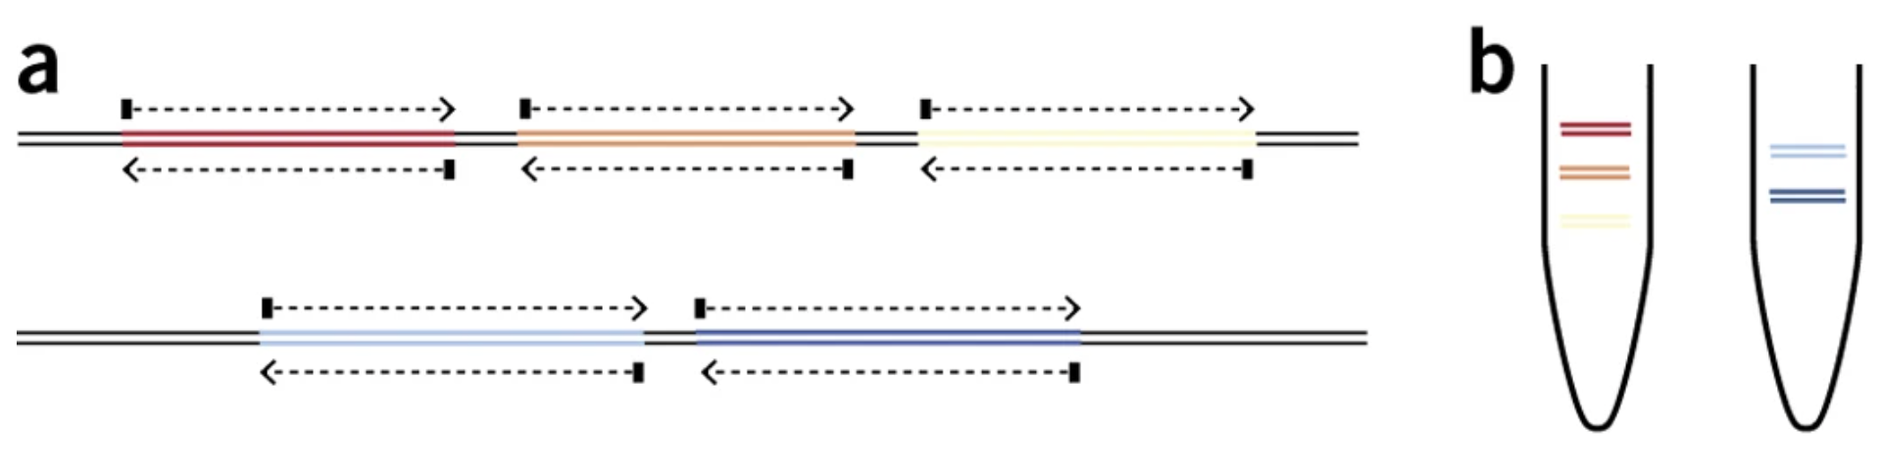
Multiplex PCR
•Q5® Hot Start High-Fidelity DNA Polymerase
Must be used, other polymerase won’t work
Has a higher Tm than other polymerases
•Mastermix contains all PCR components
Just combine with cDNA and water
Require 2 reactions per sample:
Pool A and Pool B
Pool 1
Pool 2
Pool 1
Pool 2

Slide 9
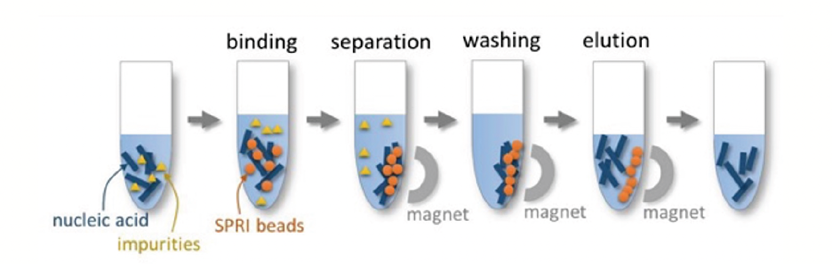
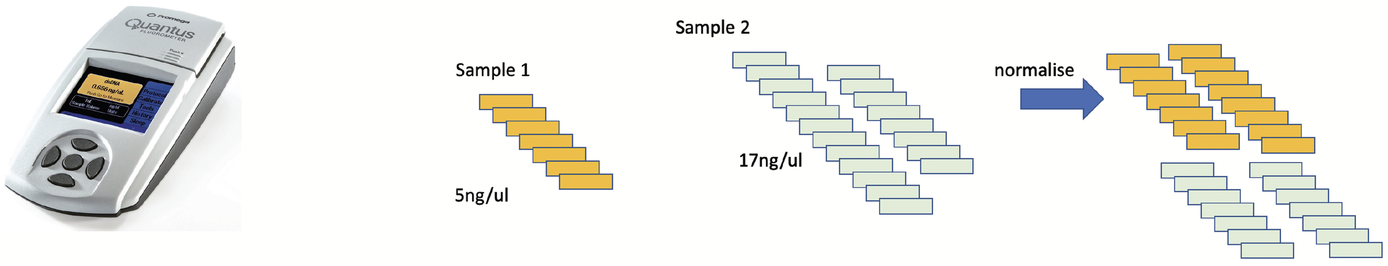
SPRI Beads Clean-up, Quantification & Normalisation
SPRI – Solid Phase Reversible Immobilisation
Quantification using fluorometer
Variation between samples
Normalisation to even the sequencing coverage across samples

Slide 10
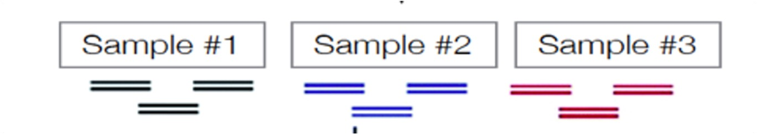
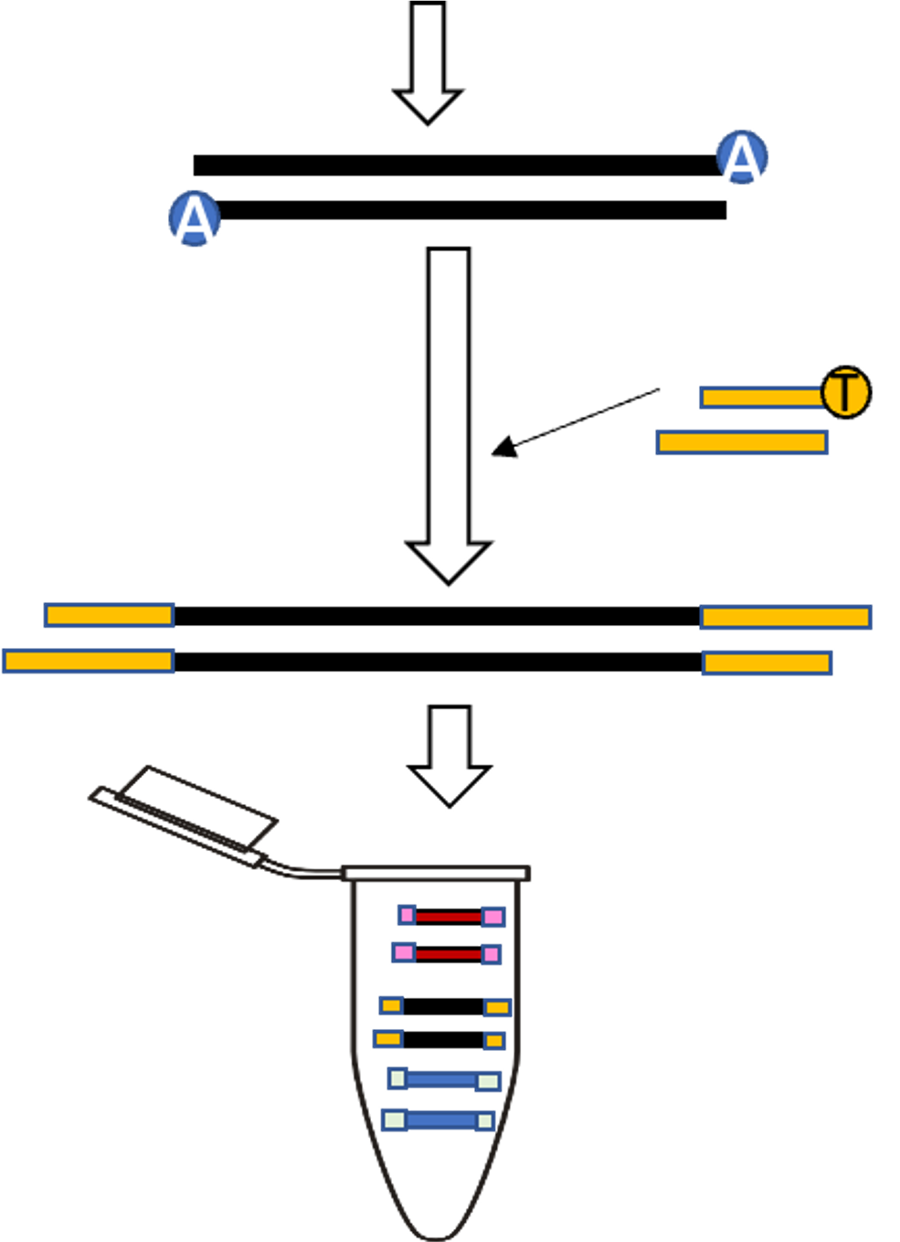
Library preparation
1. End repair/dA tailing
Add a 3’-dA tail to dsDNA
Barcoding and barcode ligation
In order to multiplex samples on one run, we need to BARCODE
Pool together barcoded DNA
Clean-up with SPRI beads
Quantify with Quantus Fluorometer
Adaptor Ligation

Slide 11
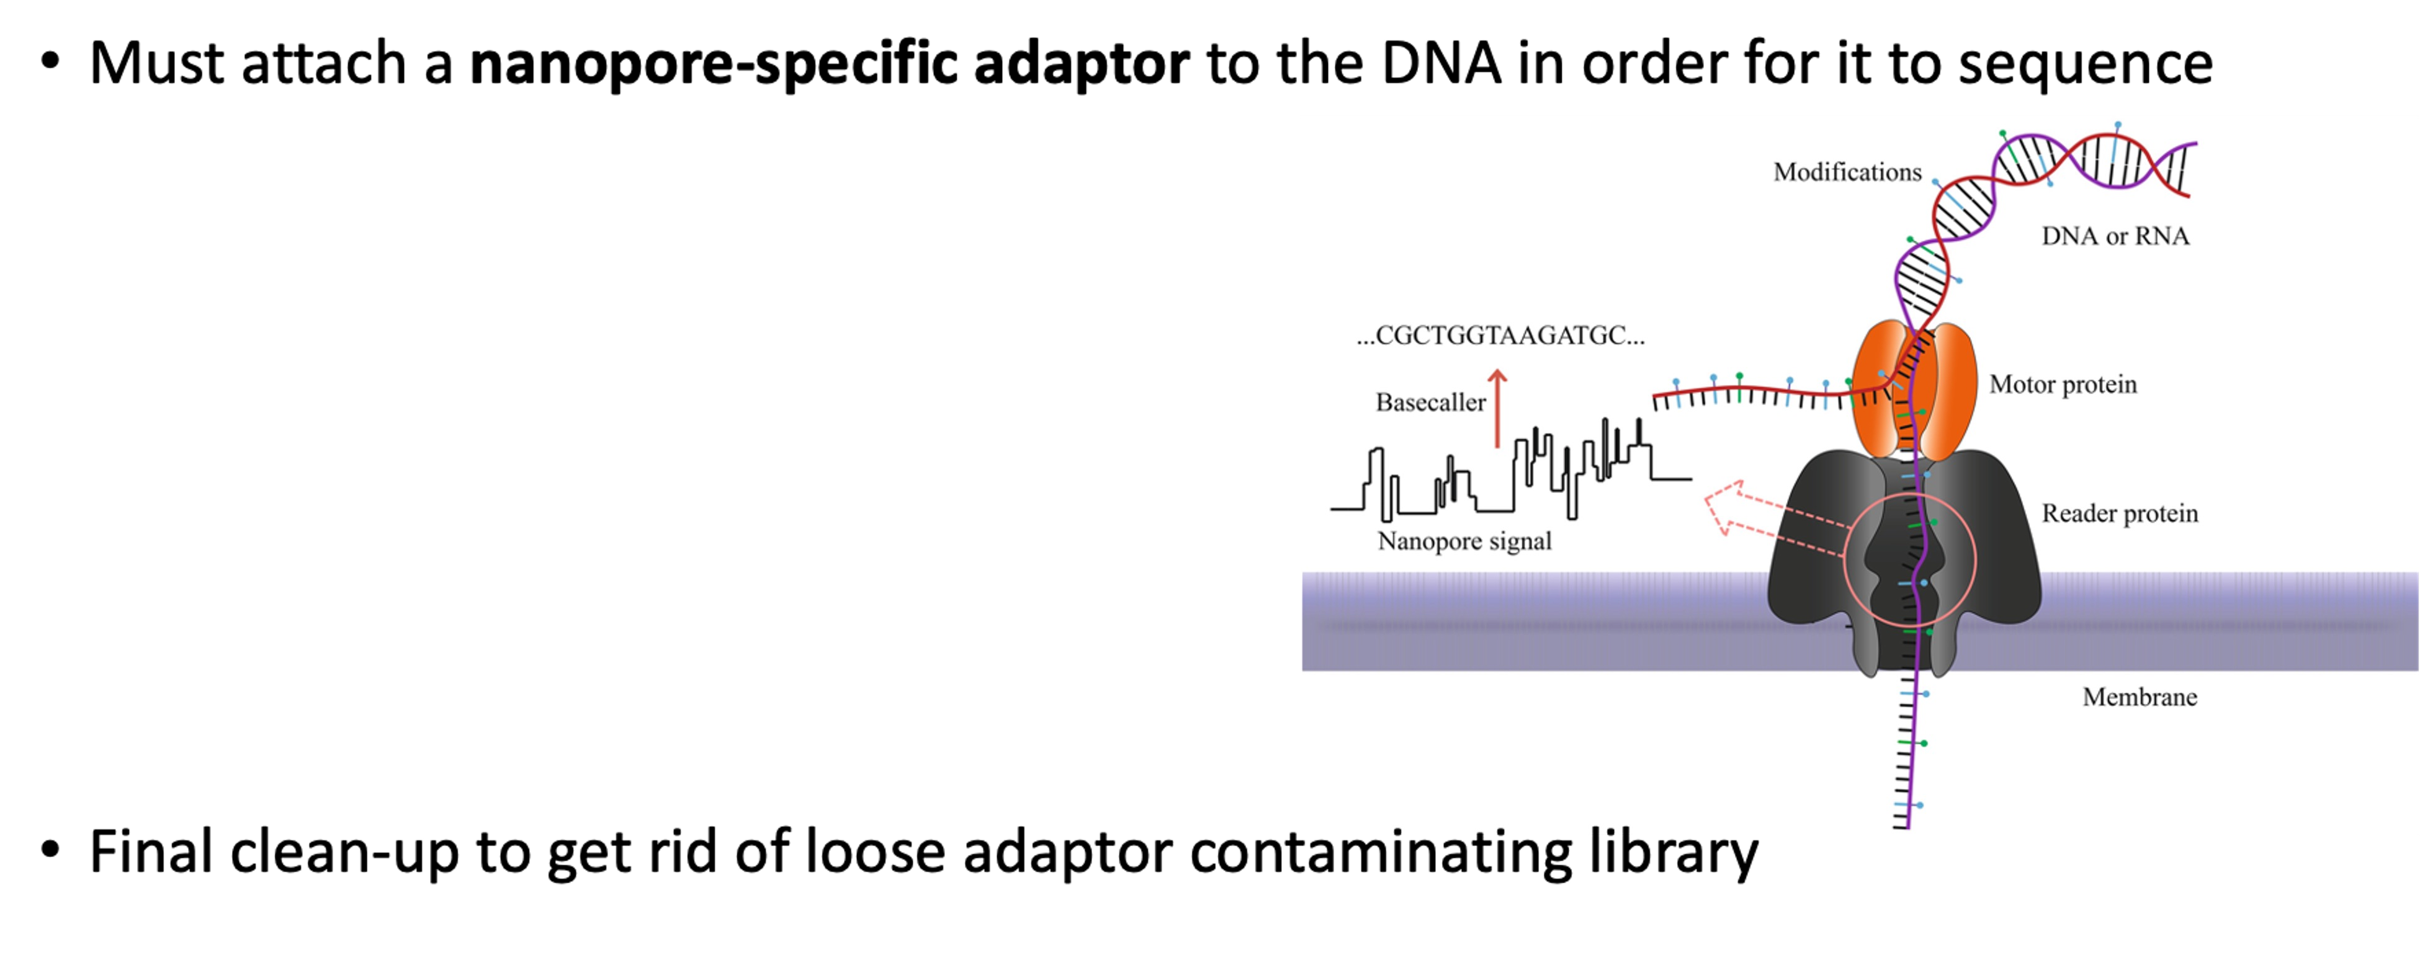
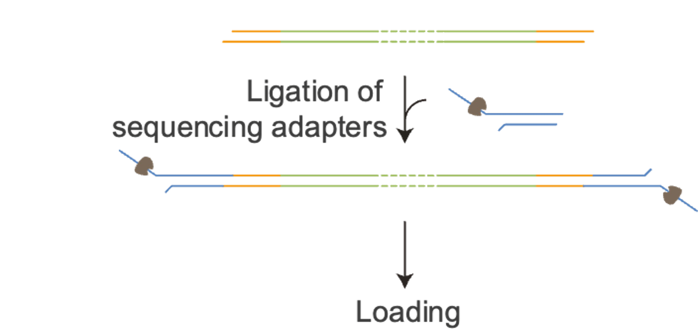
Adaptor Ligation

Slide 12
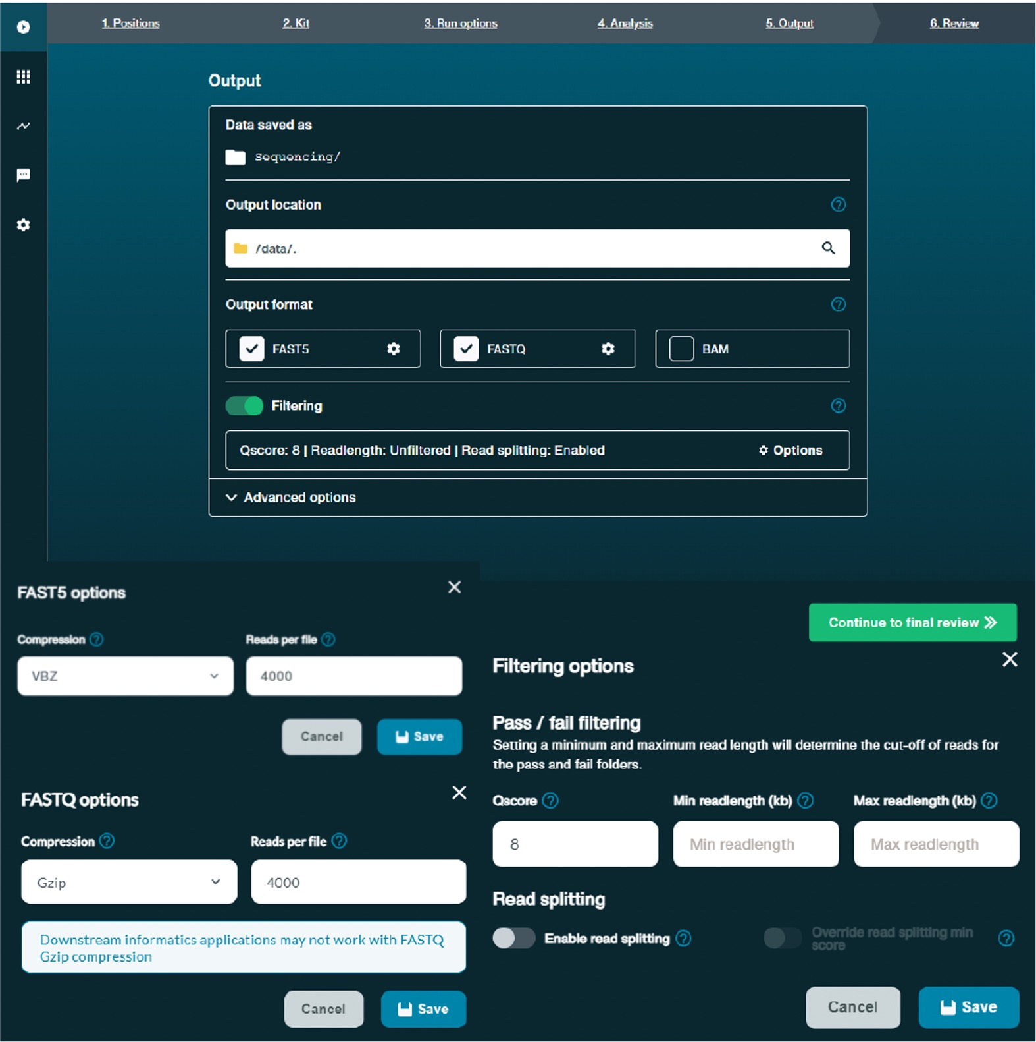
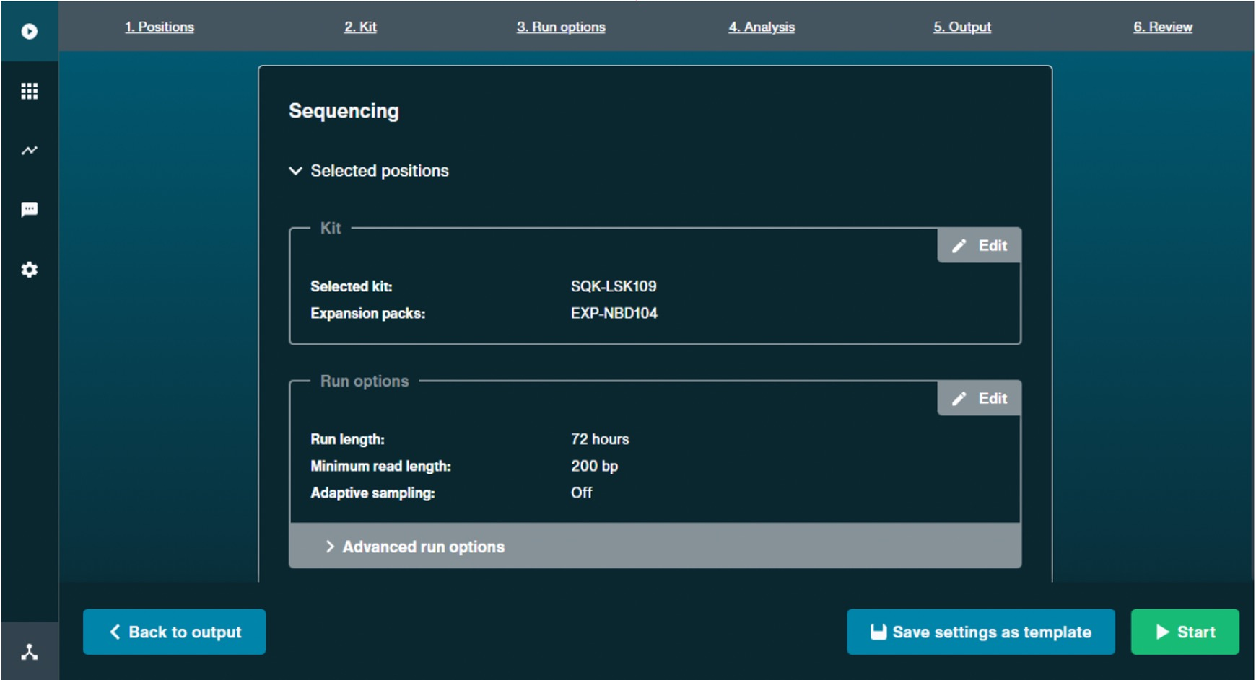
Sequencing: Minknow and RAMPART interpretation - to be shown during the actual run

Slide 13
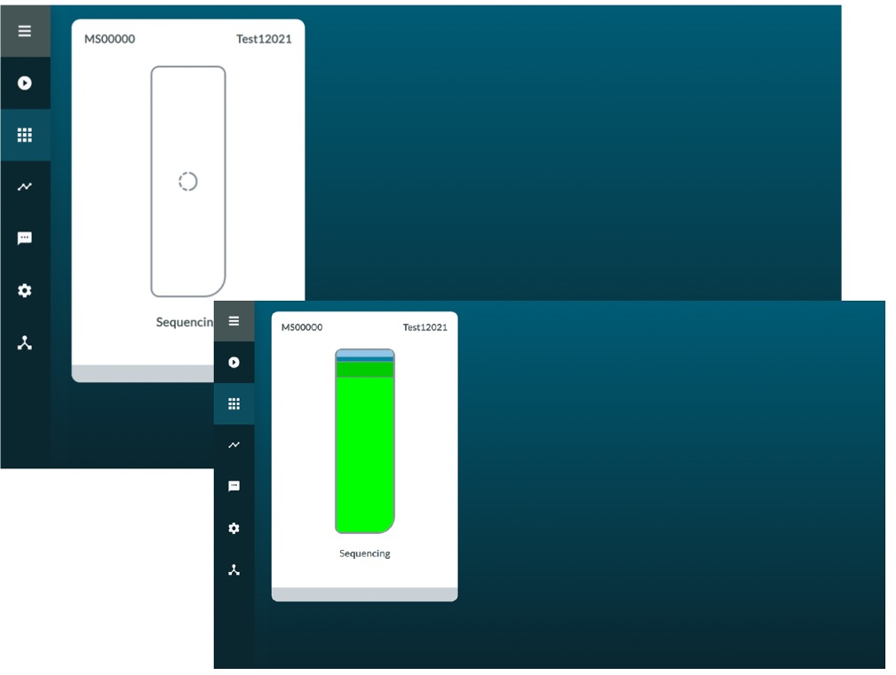
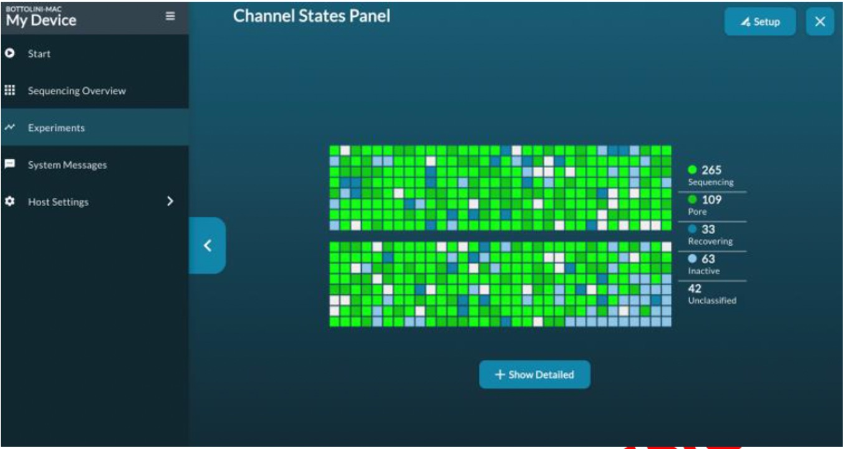
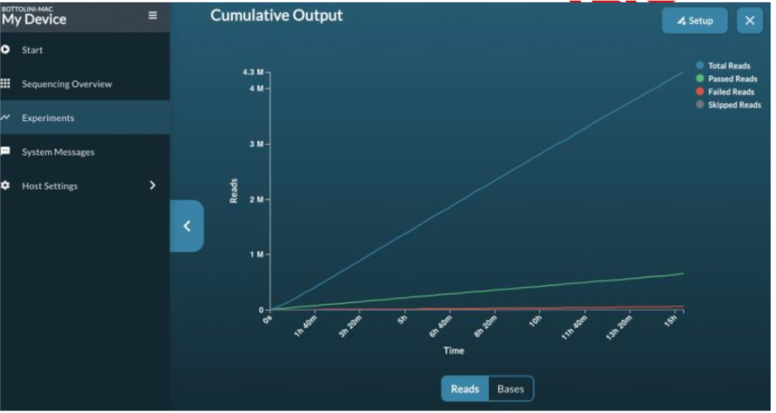
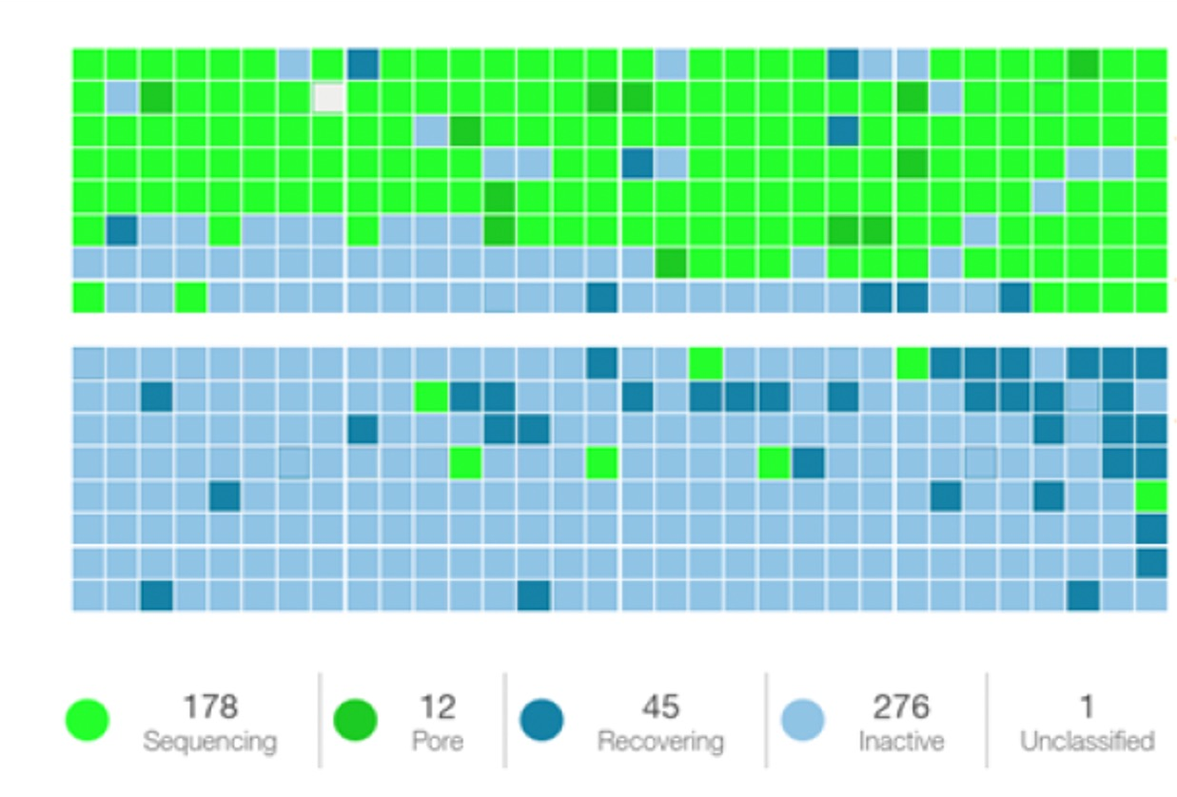
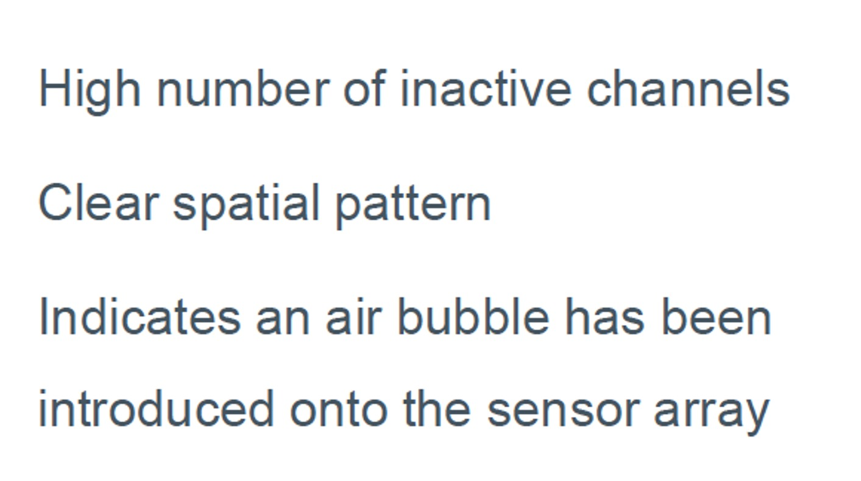
Sequencing: Minknow and RAMPART interpretation - to be shown during the actual run

Slide 14
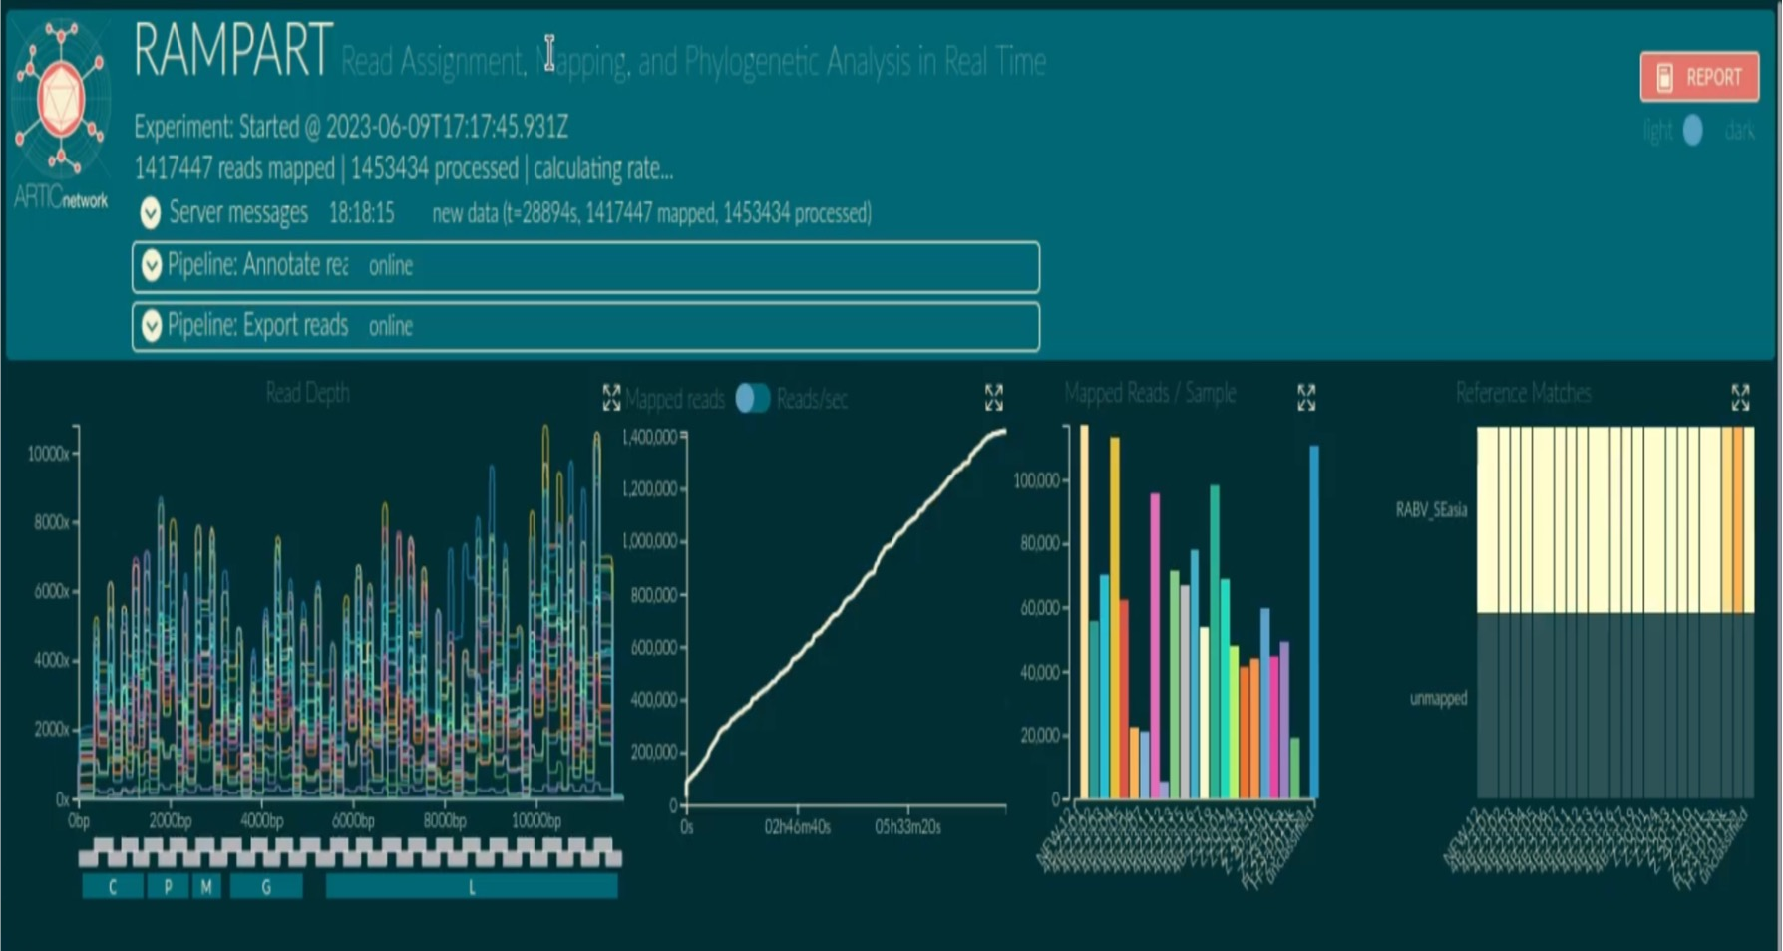
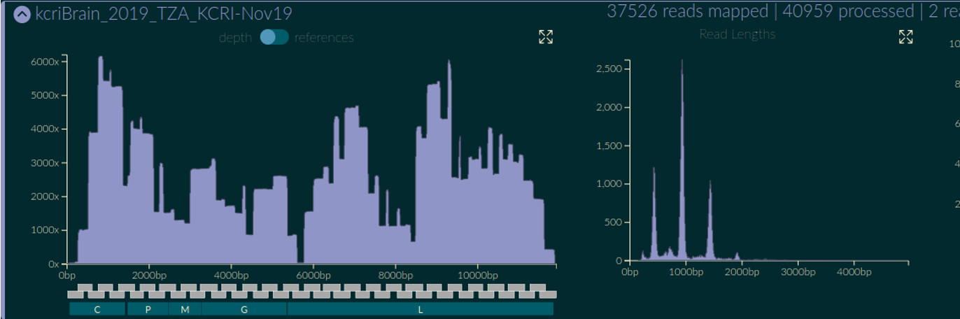
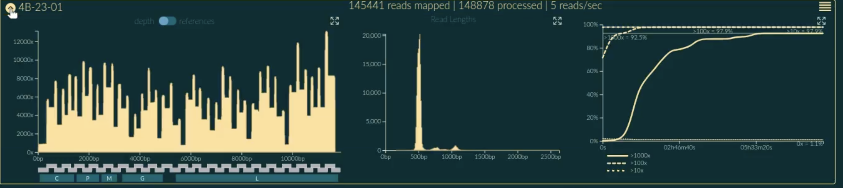
Sequencing: Minknow and RAMPART interpretation - to be shown during the actual run

Slide 15
Consensus generation
Artic-rabv pipeline
Demultiplexing
Read Filtering
Medaka consensus pipeline

Slide 16
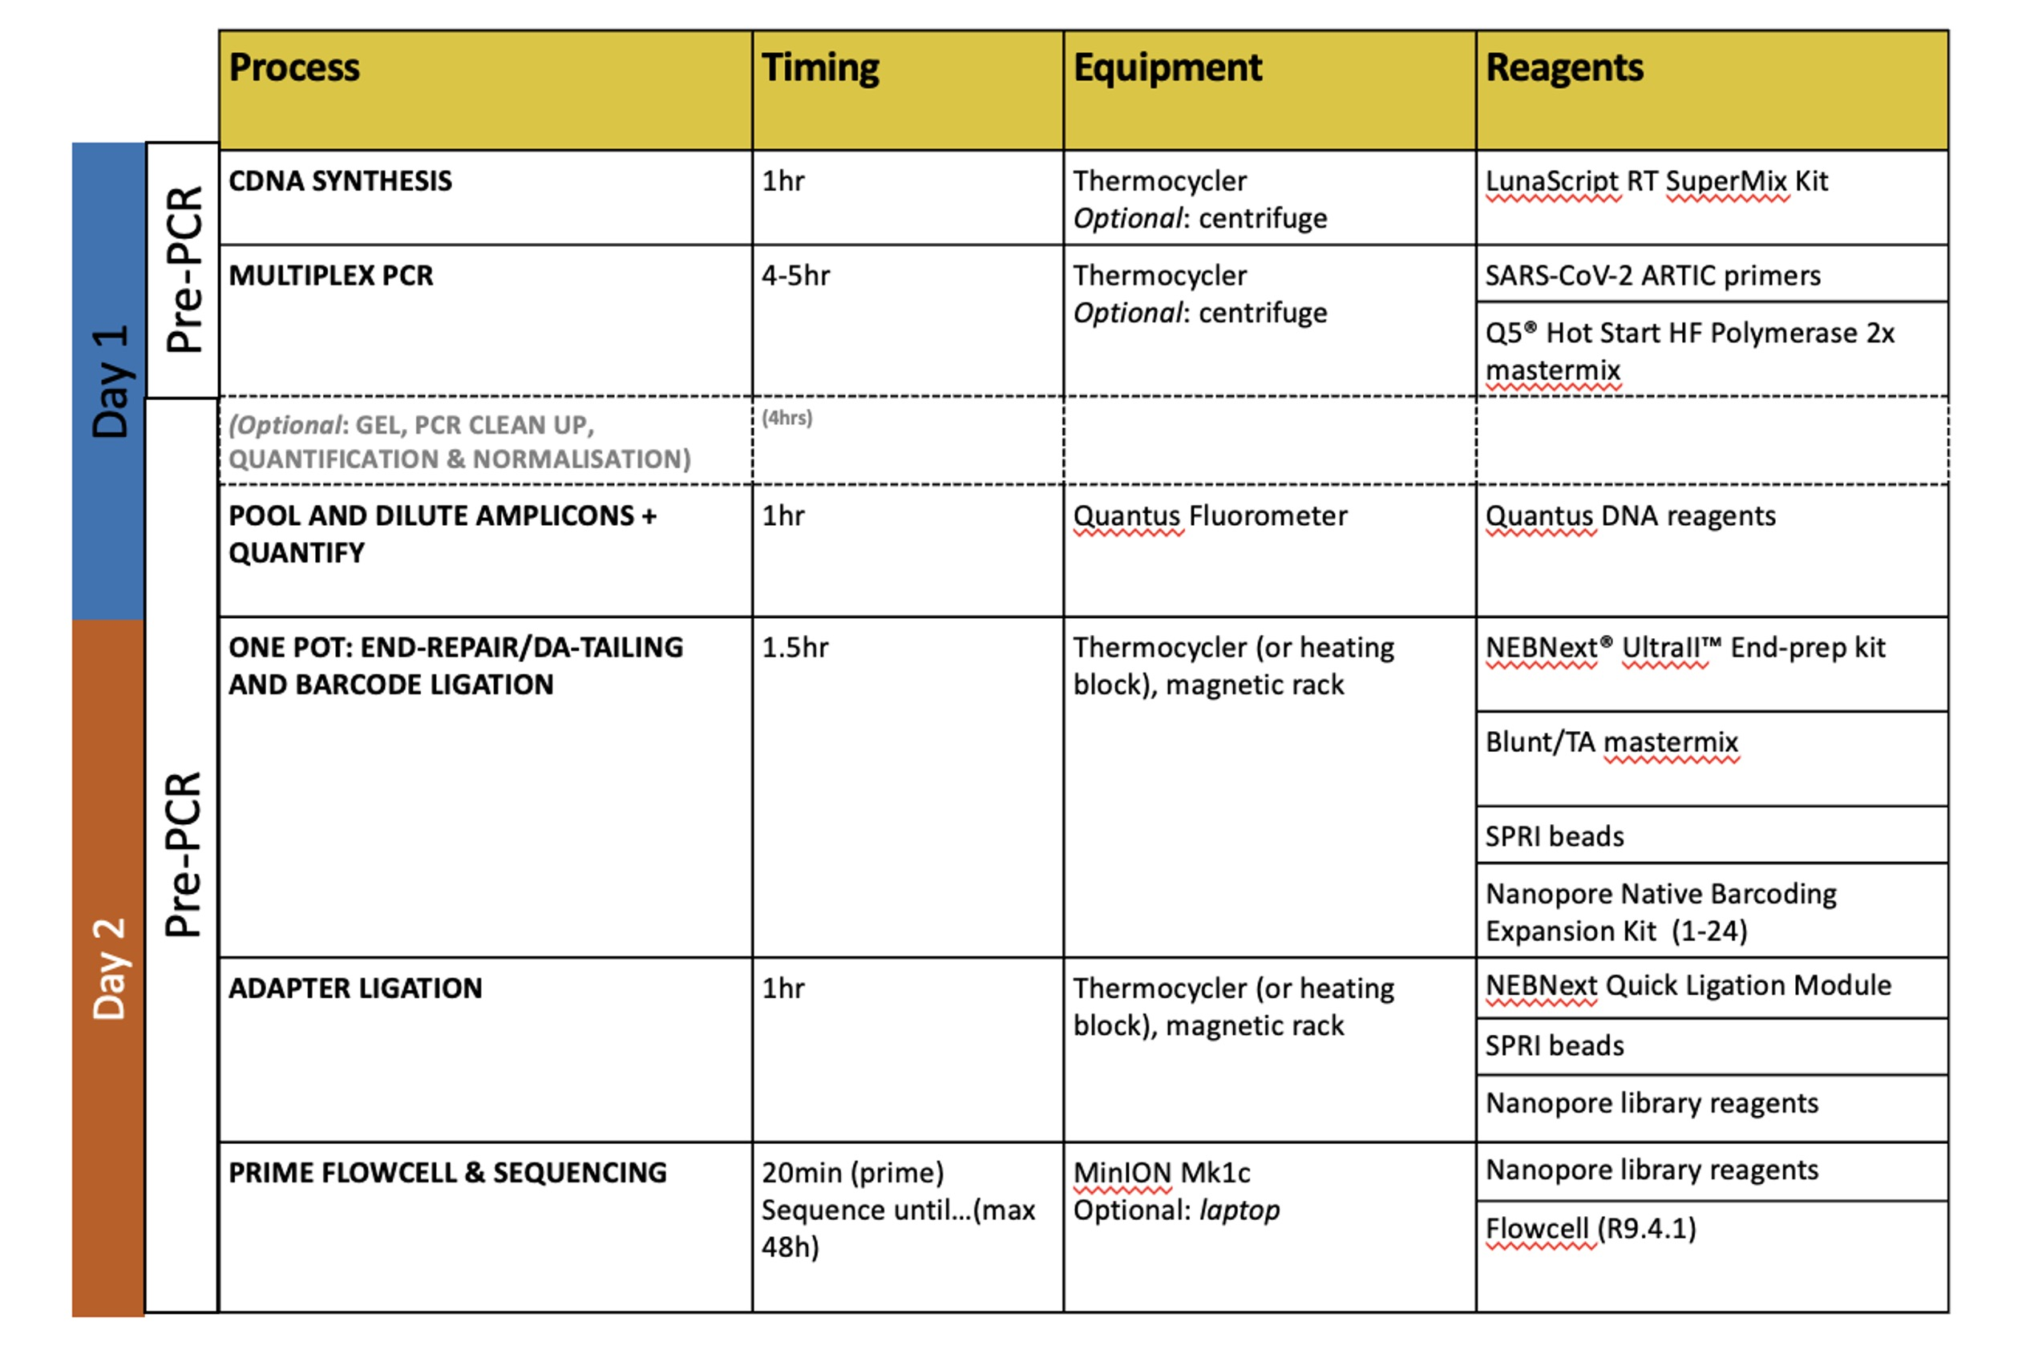
Summary
Pause point
Pause point

Slide 17
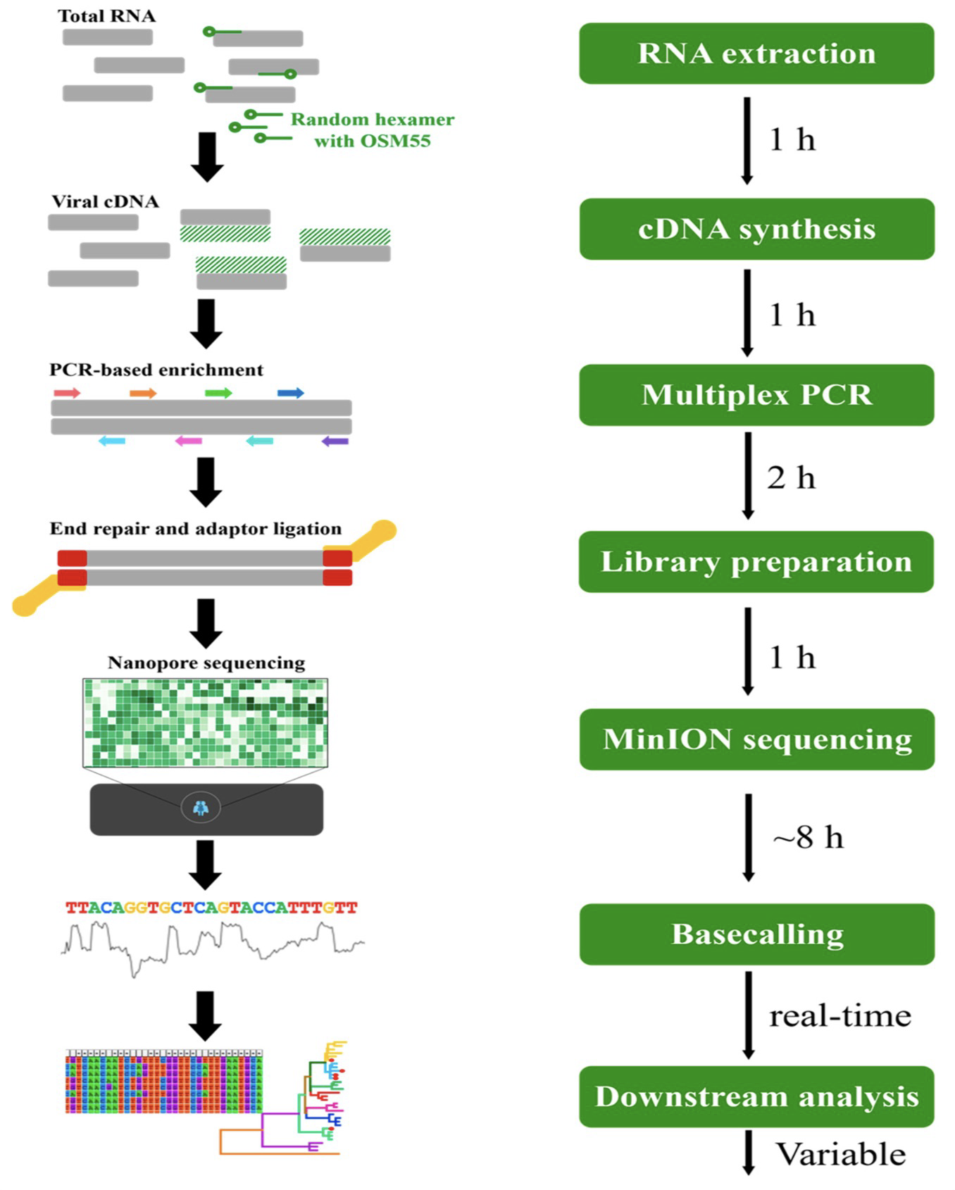
Summary
Bautista et. al., 2023 [JoVE]

Slide 18



Questions?
bit.ly/3HNX2tT
#UofGWorldChangers
@UofGlasgow

